Slide 1

PRIVACY-PRESERVING MACHINE LEARNING : SECURING DATA IN AI SYSTEMS
Protecting data privacy while leveraging AI's power.
Under the guidance of
Mr. I. Narasimha Rao, M. Tech, Assistant Professor
G. PALLAVI - 216C1A6615
B. RAGA - 216C1A6605
K. ANUSHA - 216C1A6619
K. LAXMI THULASI - 216C1A6621

Slide 2

ABSTRACT
With the rise of big data and artificial intelligence (AI), privacy concerns have become increasingly critical, especially when handling sensitive information. As AI-driven insights shape various industries, ensuring data privacy remains a key challenge.
Privacy-preserving machine learning (PPML) has emerged as a crucial field, balancing the need for data utilization with stringent privacy protections. This research explores key PPML techniques for safeguarding sensitive data while enabling AI model training. It examines methodologies such as differential privacy, homomorphic encryption, federated learning, and secure multiparty computation (SMPC), assessing their effectiveness in protecting data within AI systems.
Additionally, this study highlights the challenges of implementing PPML, including computational overhead and maintaining model accuracy. By evaluating the strengths and limitations of different privacy-preserving approaches, this research provides valuable insights for decision-makers and practitioners, guiding them toward effective strategies for securing data while harnessing AI's potential.

Slide 3

INTRODUCTION
With the rise of AI, protecting sensitive data such as health and financial records has become a priority.
Traditional ML often aggregates data centrally, posing privacy risks.
PPML addresses these risks by enabling data-driven insights without compromising individual privacy.
This presentation introduces core PPML techniques and their applications in real-world scenarios.

Slide 4

Existing System
In traditional machine learning systems, data is collected from various sources and stored centrally on a server for model training.
While this approach is effective for performance, it introduces significant privacy and security risks, especially when sensitive data like health records, financial information, or personal identifiers is involved.
Users have limited control over their data, and existing models are vulnerable to leaks and attacks. These issues highlight the need for better solutions like Privacy-Preserving Machine Learning (PPML), which protects data without compromising performance.
Advantages :
High accuracy and performance
Simplified data integration

Slide 5
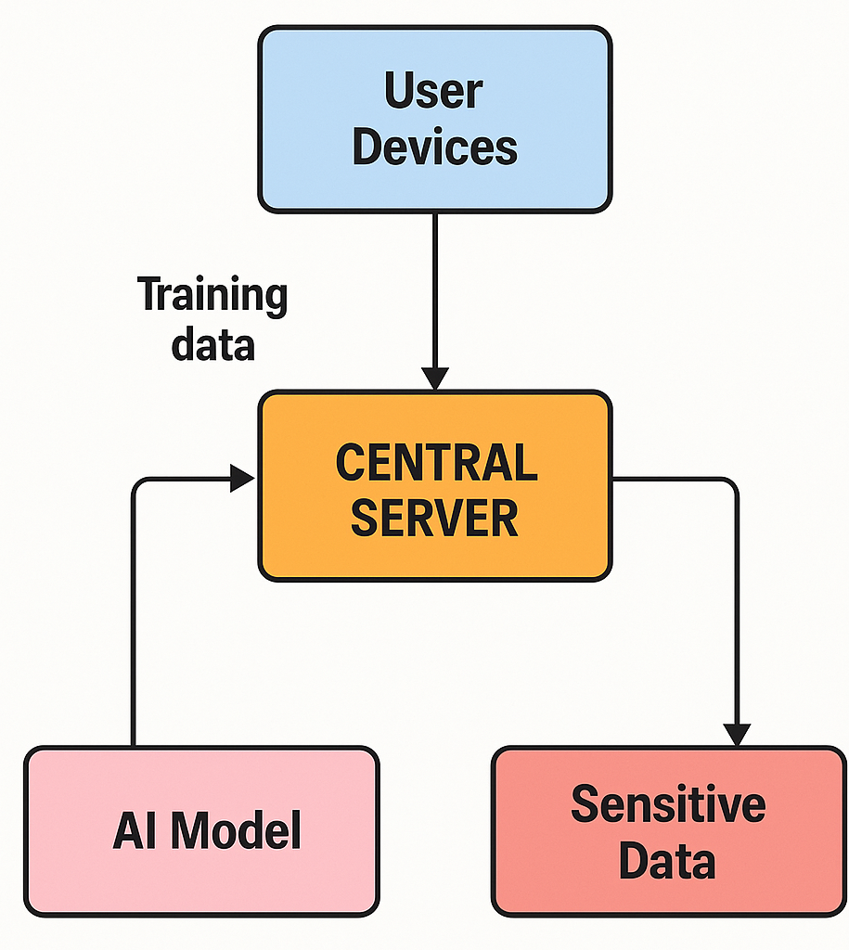
Process Include:
1
Data Collection:
Data is gathered from multiple users or devices (e.g., mobile phones, sensors, websites).
This data often includes personal or sensitive information.
3
Model Training:
Machine learning models are trained using the data stored on the central server.
The entire dataset is accessible in one place for model optimization.
2
Centralized Storage:
All collected data is sent to a central server.
The server stores and organizes this data for analysis and training.
4
Deployment & Inference:
The trained AI model is used to make predictions or decisions.
These predictions may indirectly expose patterns from the training data.

Slide 6

Existing System Challenges
Disadvantages:
Centralized data increases breach risks
Weak privacy safeguards
Greater potential for insider threats
Difficulty in meeting privacy regulations (GDPR, HIPAA)
Privacy Risk Exposure
Limited User Control
Model inversion attacks

Slide 7
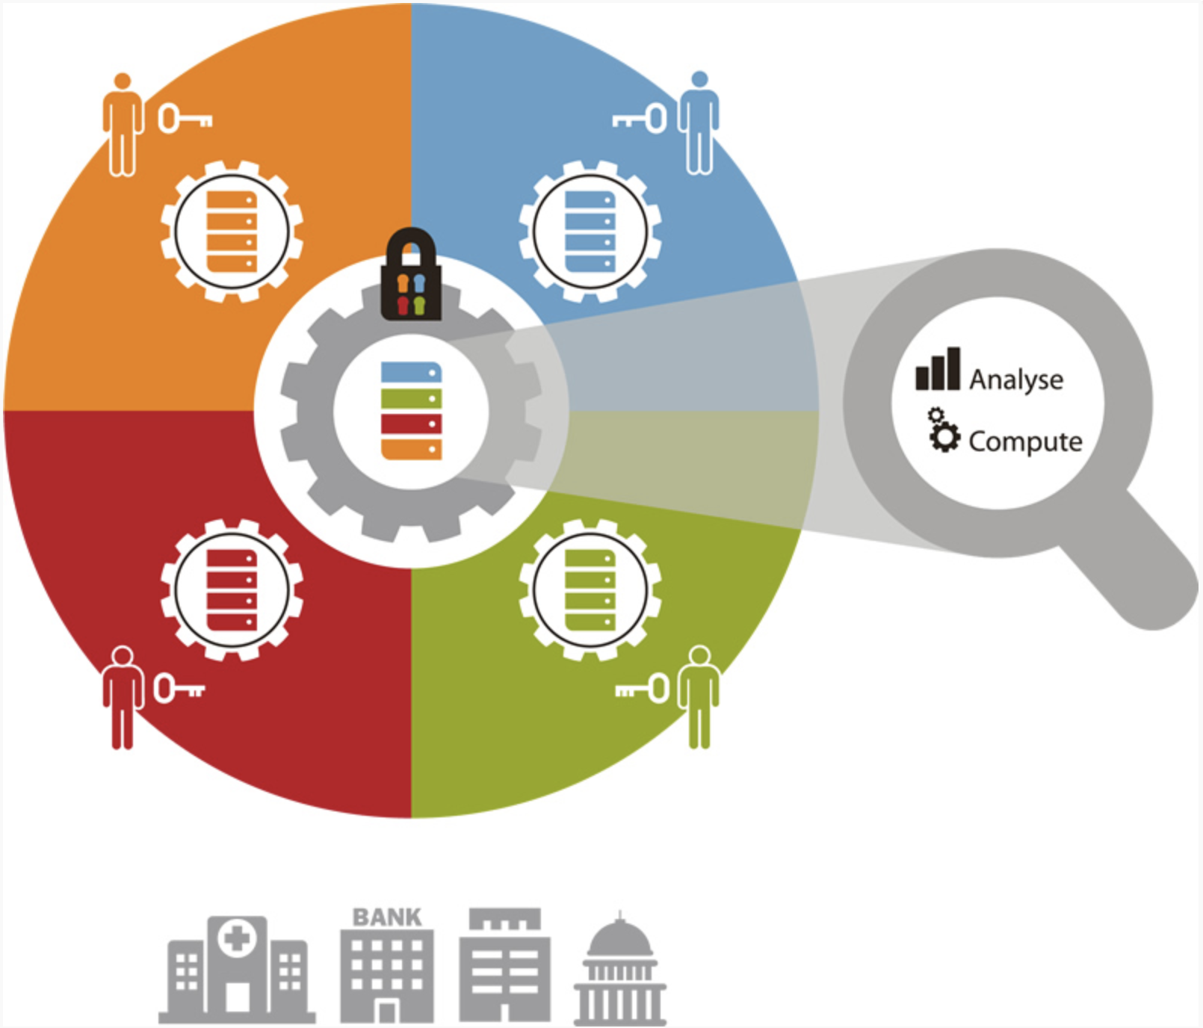



Applications of the Existing System
Healthcare: Predict diseases while keeping patient data
private.
Finance: Fraud detection and credit scoring
Telecom: Anomaly detection and targeted recommendations

Slide 8

Proposed System
To enhance data privacy in AI systems, the proposed solution integrates a hybrid approach combining Federated Learning, Differential Privacy, and Homomorphic Encryption into a unified machine learning framework. This multi-layered strategy ensures robust data protection at every stage of the ML lifecycle.
The system starts by identifying and removing unrelated data using K-Means clustering.
Then, it applies Differential Privacy to obscure sensitive features while preserving data utility.
Homomorphic Encryption further enhances security by enabling computations on encrypted data.
Model training is performed using Federated Learning, where data remains local on each user’s device, and only the model updates are shared.
Secure Multi-party Computation enables collaborative analysis between multiple parties without revealing individual datasets.
This architecture enhances the security and transparency of AI systems, making them suitable for sensitive applications like healthcare and finance. It also supports ethical AI development by aligning with privacy regulations.

Slide 9
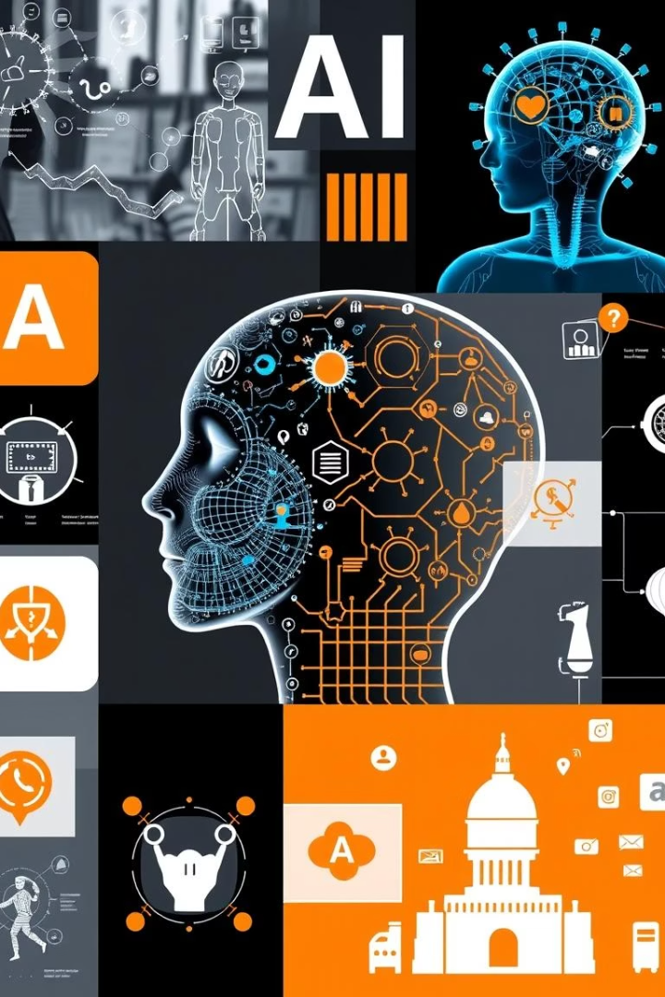
Advantages and Disadvantages of the Proposed System
Advantages:
User data remains private
Scalable across sectors
Builds user trust and regulatory compliance
Enables secure collaboration across institutions
Suitable for handling highly sensitive data
Disadvantages:
Increased computational overhead
Complexity in implementation
Trade-off between privacy and accuracy

Slide 10
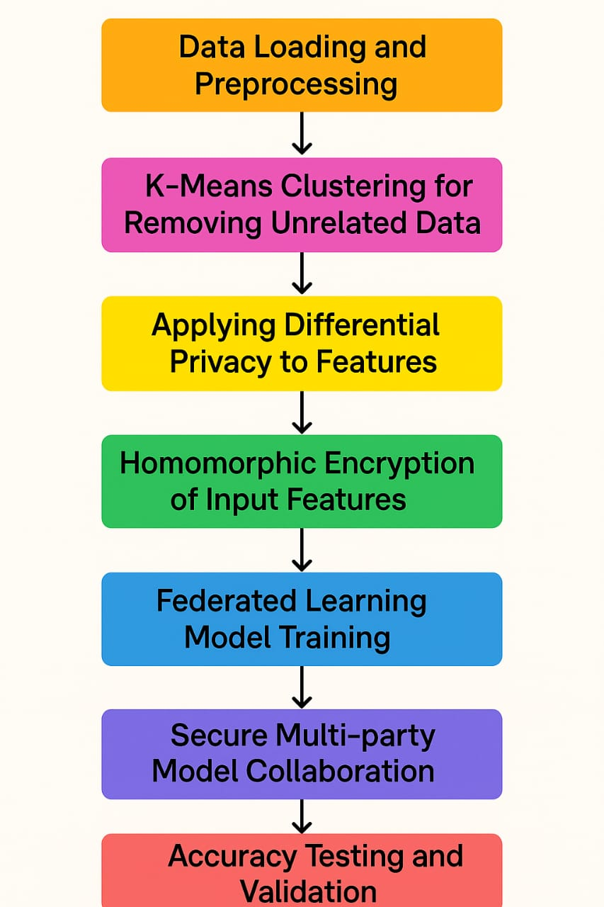
Life Cycle of Proposed System
1. Data Loading and Preprocessing:
Load the raw dataset, clean the missing values, normalize the data, and prepare it for model training.
5. Federated Learning Model Training: Train the model locally on user devices; only model updates are shared, keeping user data private.
2. K-Means Clustering for Removing Unrelated Data: Apply K-Means to group similar data points and remove outliers or irrelevant records for better model quality.
6. Secure Multi-party Model Collaboration: Use SMPC to securely combine models from different sources without exposing any individual data.
3. Applying Differential Privacy to Features: Add controlled noise to sensitive features to protect individual data privacy during analysis and training.
7. Accuracy Testing and Validation: Test and validate the final model using accuracy, precision, and recall to ensure strong and privacy-safe performance.
4. Homomorphic Encryption of Input Features: Encrypt the data so computations can happen directly on encrypted values without exposing original information.

Slide 11
Software & Hardware Specifications
SOFTWARE SPECIFICATIONS:
Windows 10/11, macOS
Python Version: 3.7 or later
Python (TensorFlow Privacy)
Jupyter Notebook
Libraries: Numpy, pandas, matplotlib, sklearn, PyCryptodome, customtkinter, and more
HARDWARE SPECIFICATIONS:
Processor: Intel core i3 or above.
64-bit, quad-core, 2.5 GHz minimum per core
Hard disk: 10 GB of available space or more.
Display: Dual XGA (1920 x 1080) or higher resolution
monitors
GPU: Recommended
Storage: 500GB HDD/SSD

Slide 12
Modules used
Login Module (login.py):
Provides authentication to access the application. Prevents unauthorized access to sensitive operations.
Data Preprocessing Module (app.py):
Handles data loading, inspection, missing value detection, and visualization. Prepares the dataset for training.
Differential Privacy Module:
Adds noise to sensitive features so that individual records cannot be re-identified. Ensures data privacy during analysis.
Homomorphic Encryption Module (Homomorphic.py):
Encrypts input data so that computations can be performed on encrypted values without decrypting them.
Federated Learning Module:
Trains models locally on user devices and combines the results, allowing collaborative learning without sharing raw data.
SMPC(Secure Multi-party Computation) Module:
Enables multiple parties to jointly compute functions over their data while keeping that data private.
Model Evaluation and Visualization Module:
Uses metrics like accuracy, precision, recall, and F1-score. Displays confusion matrices and ROC curves for easy interpretation.

Slide 13

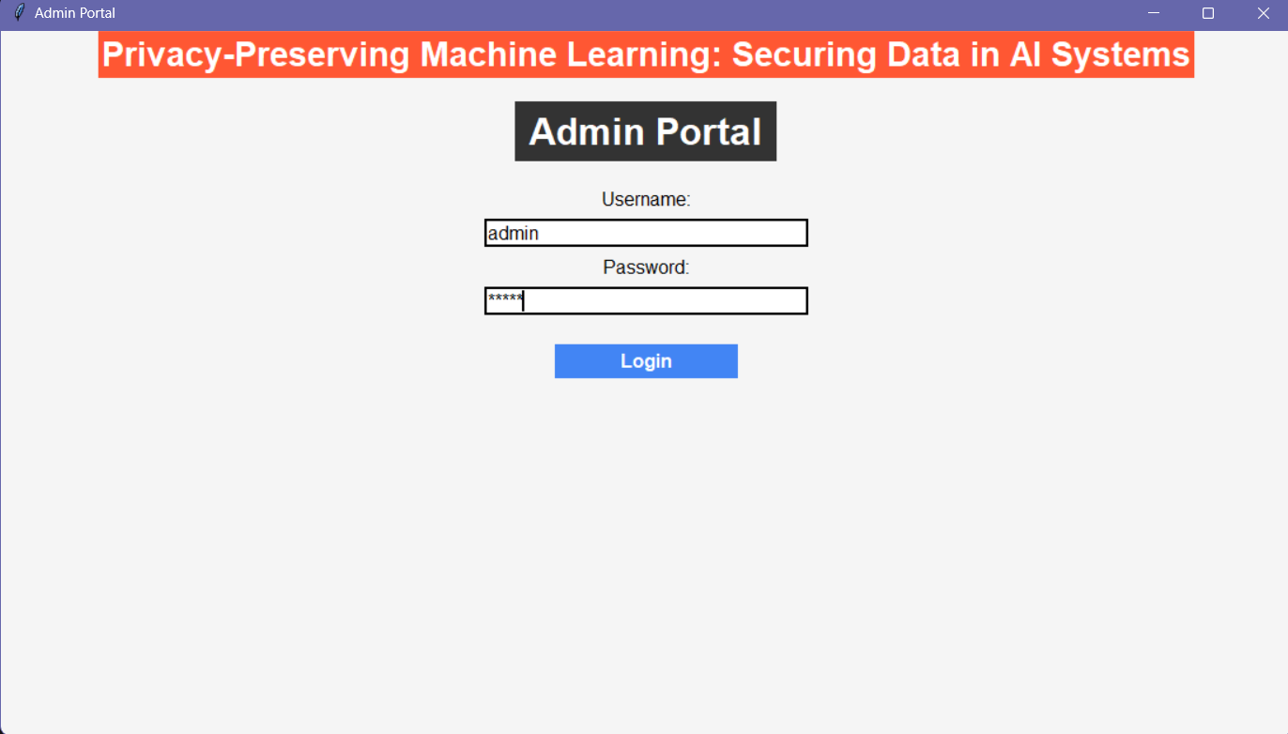
1
Login Module: Provides authentication to access the application. Prevents unauthorized access to sensitive operations.

Slide 14
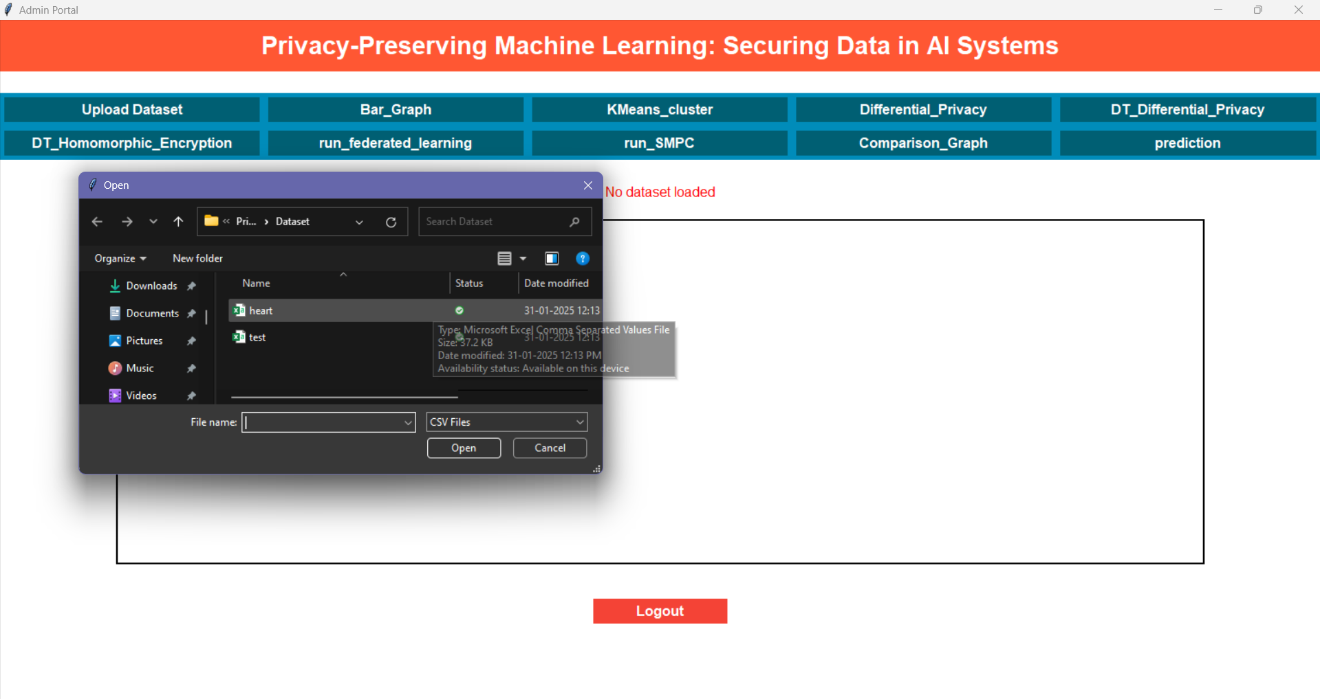
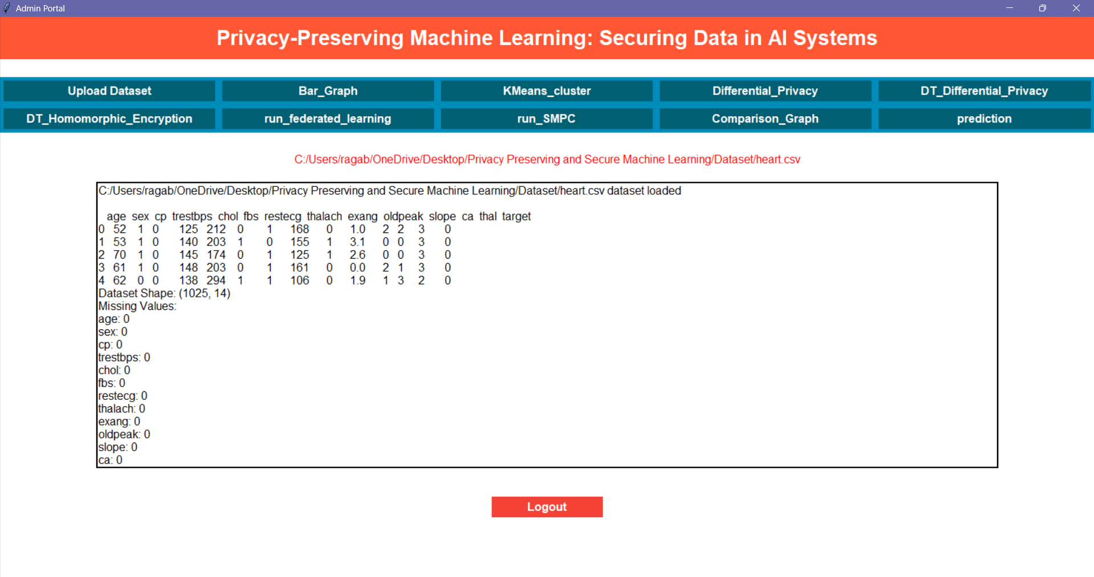
2
The “Upload Dataset” button will upload the heart dataset and preprocess the data.

Slide 15
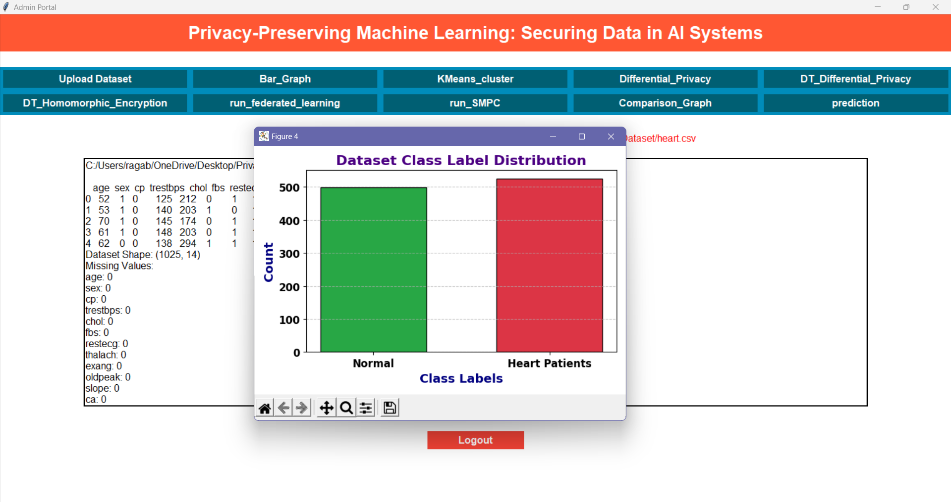
3

Slide 16
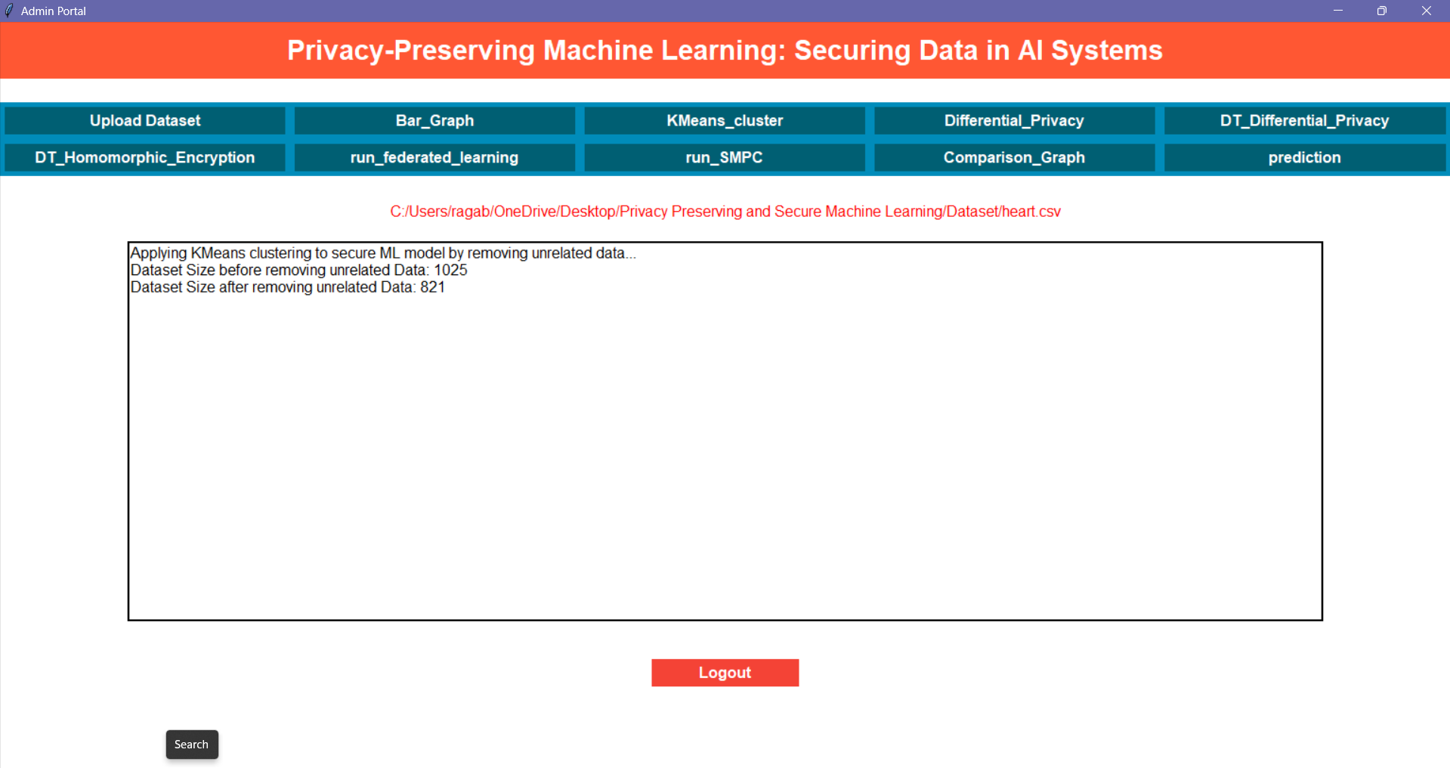
4

Slide 17
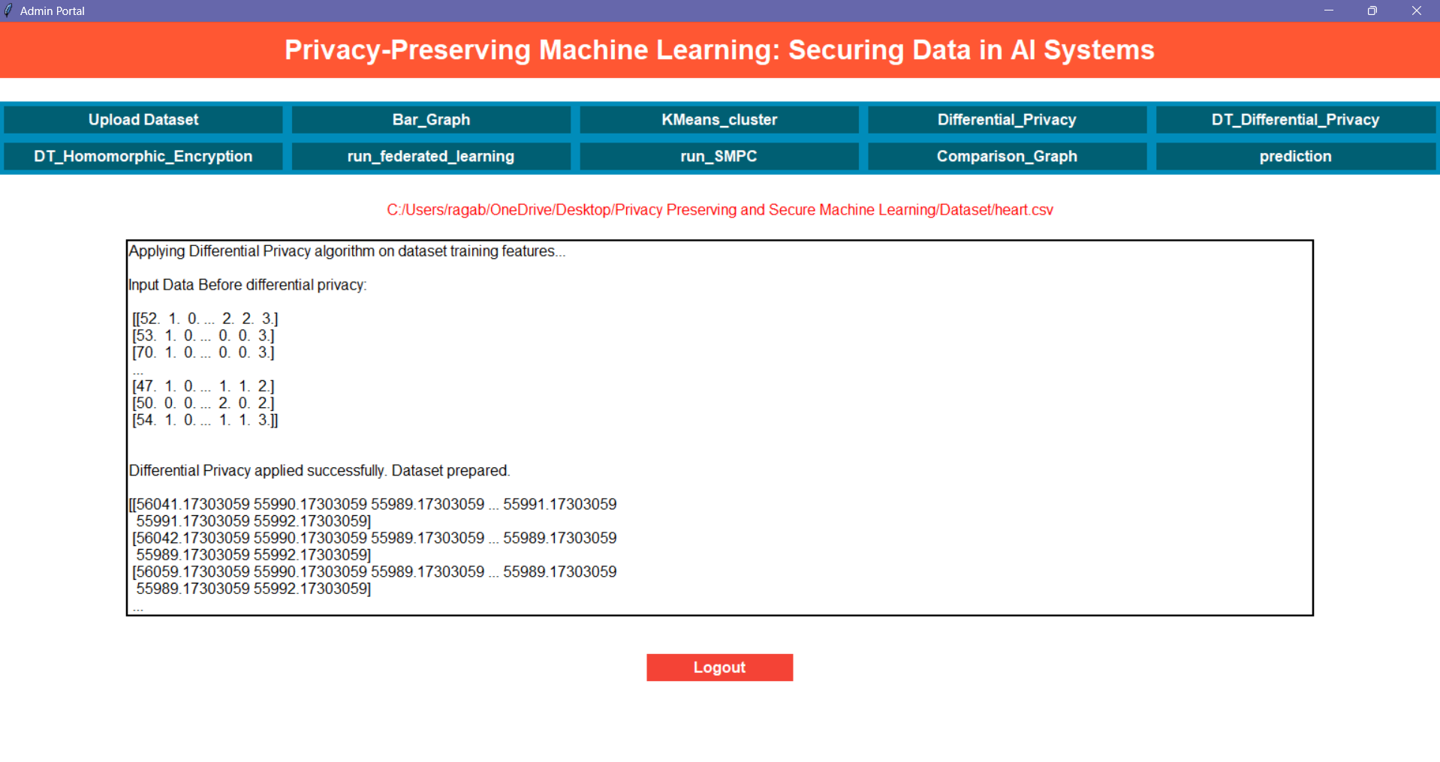
5

Slide 18
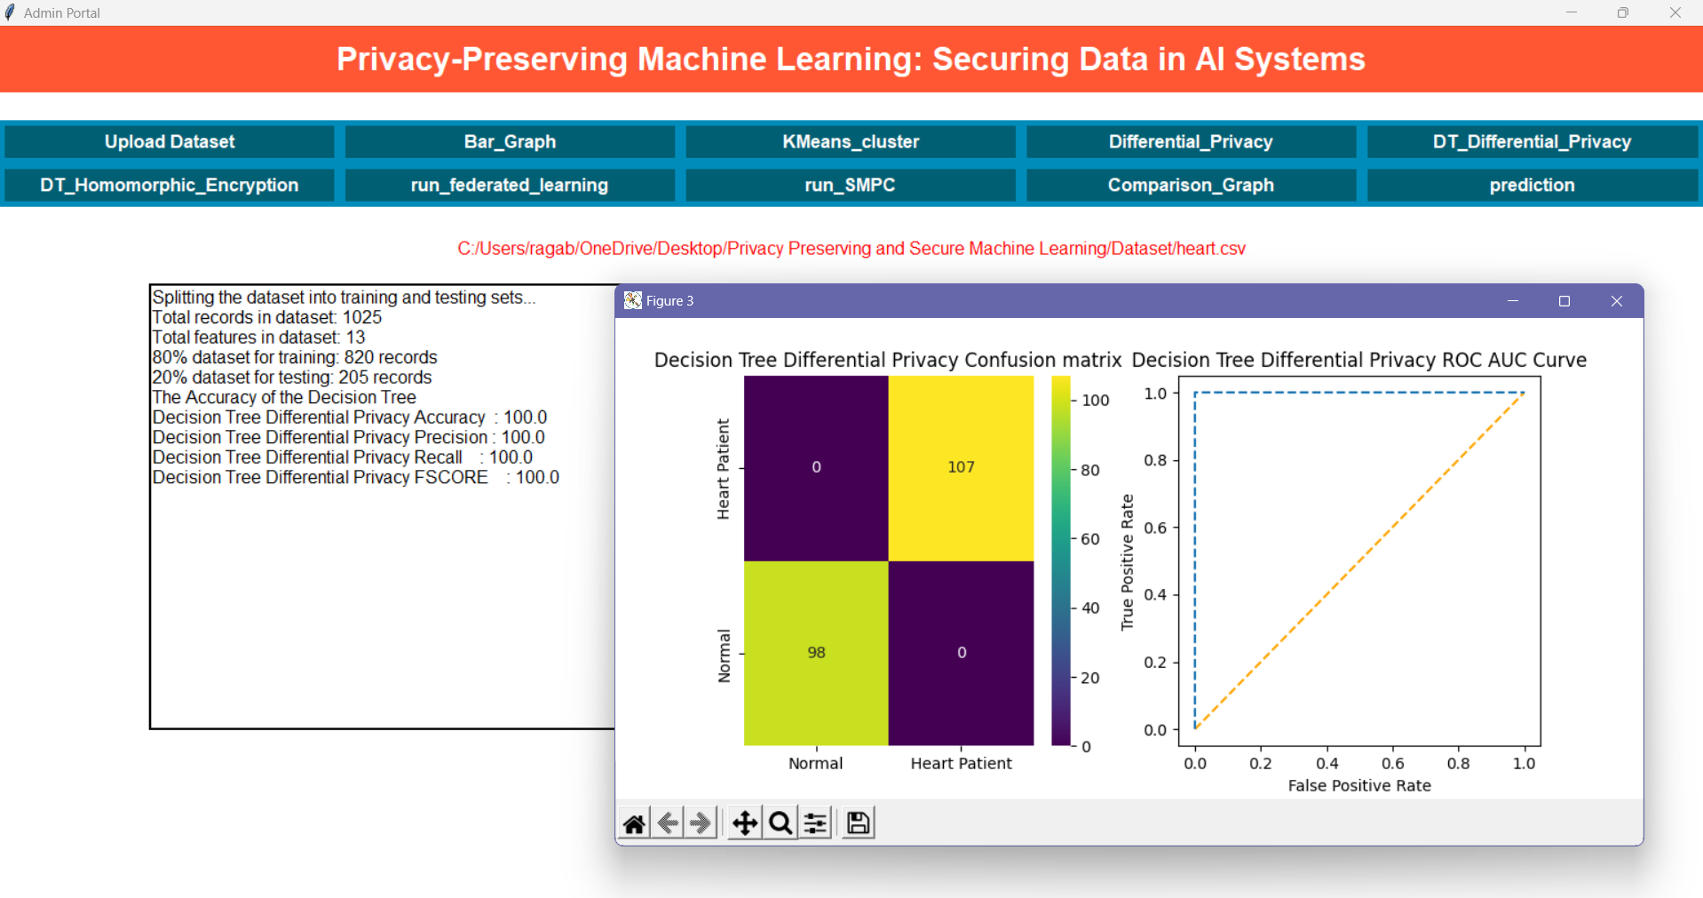
6

Slide 19
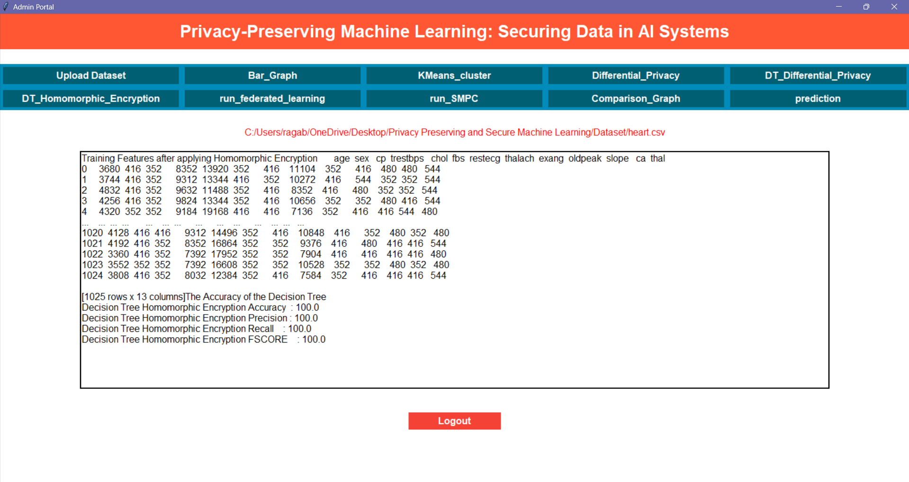
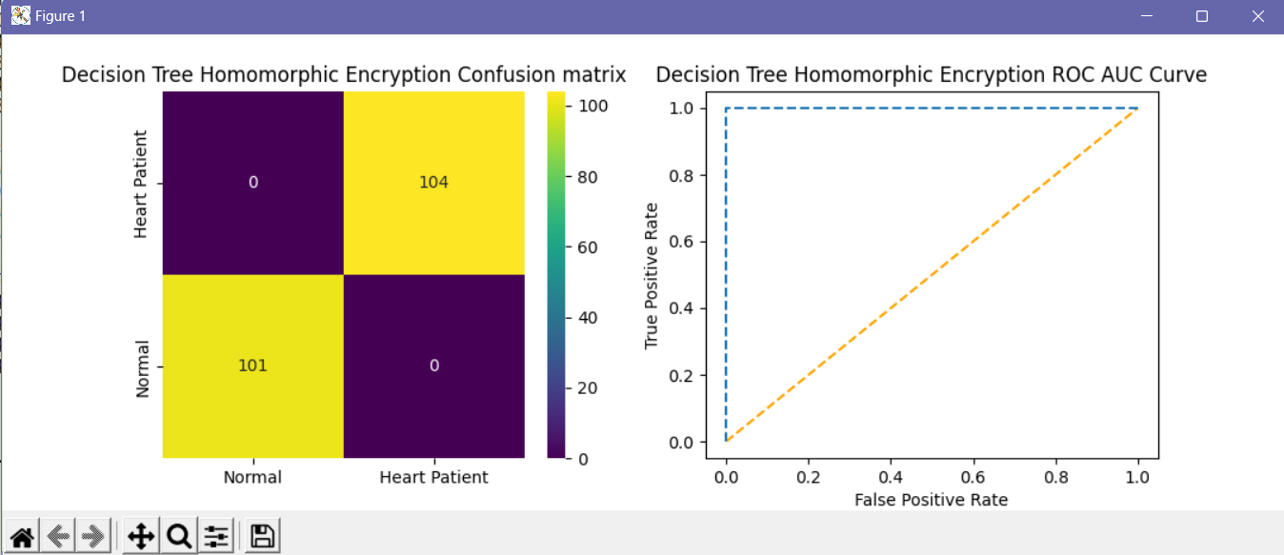
7

Slide 20
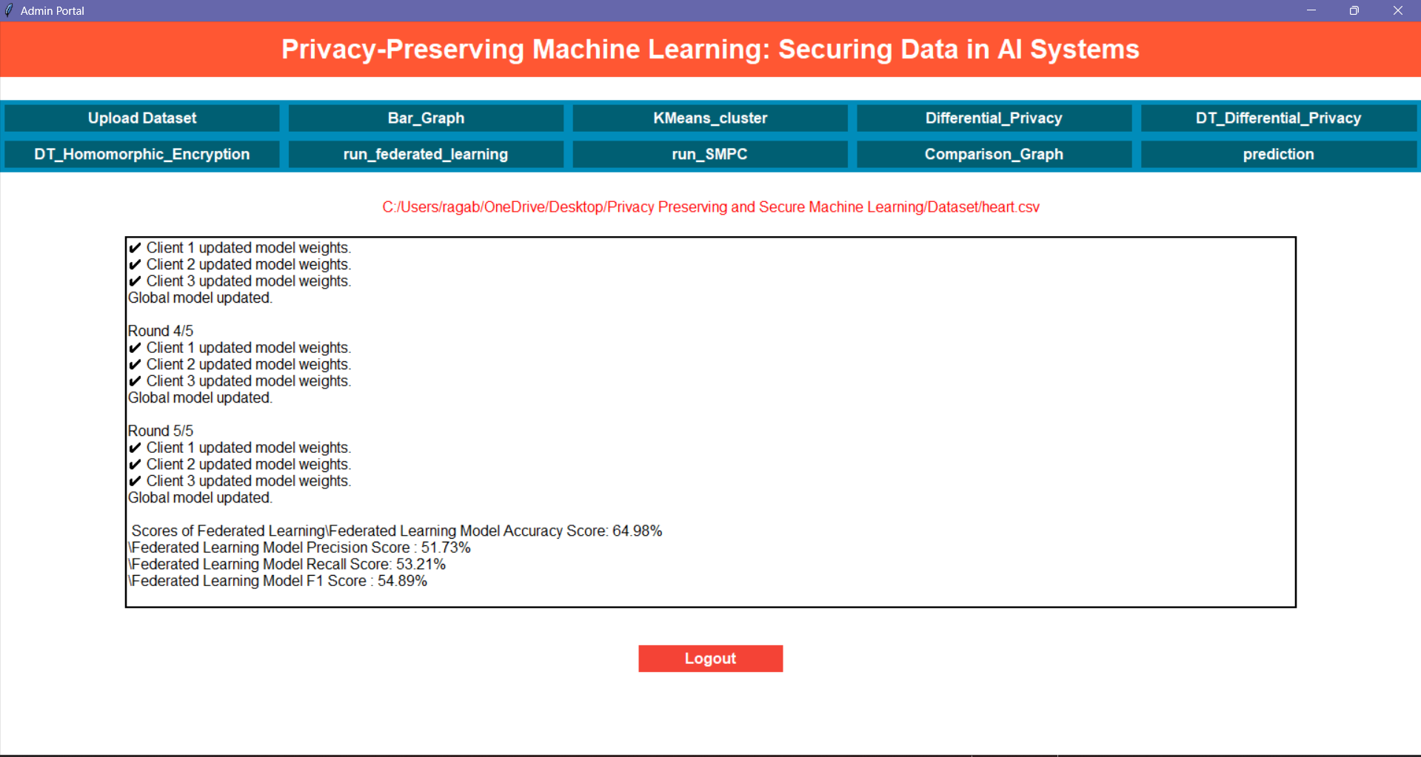
8

Slide 21
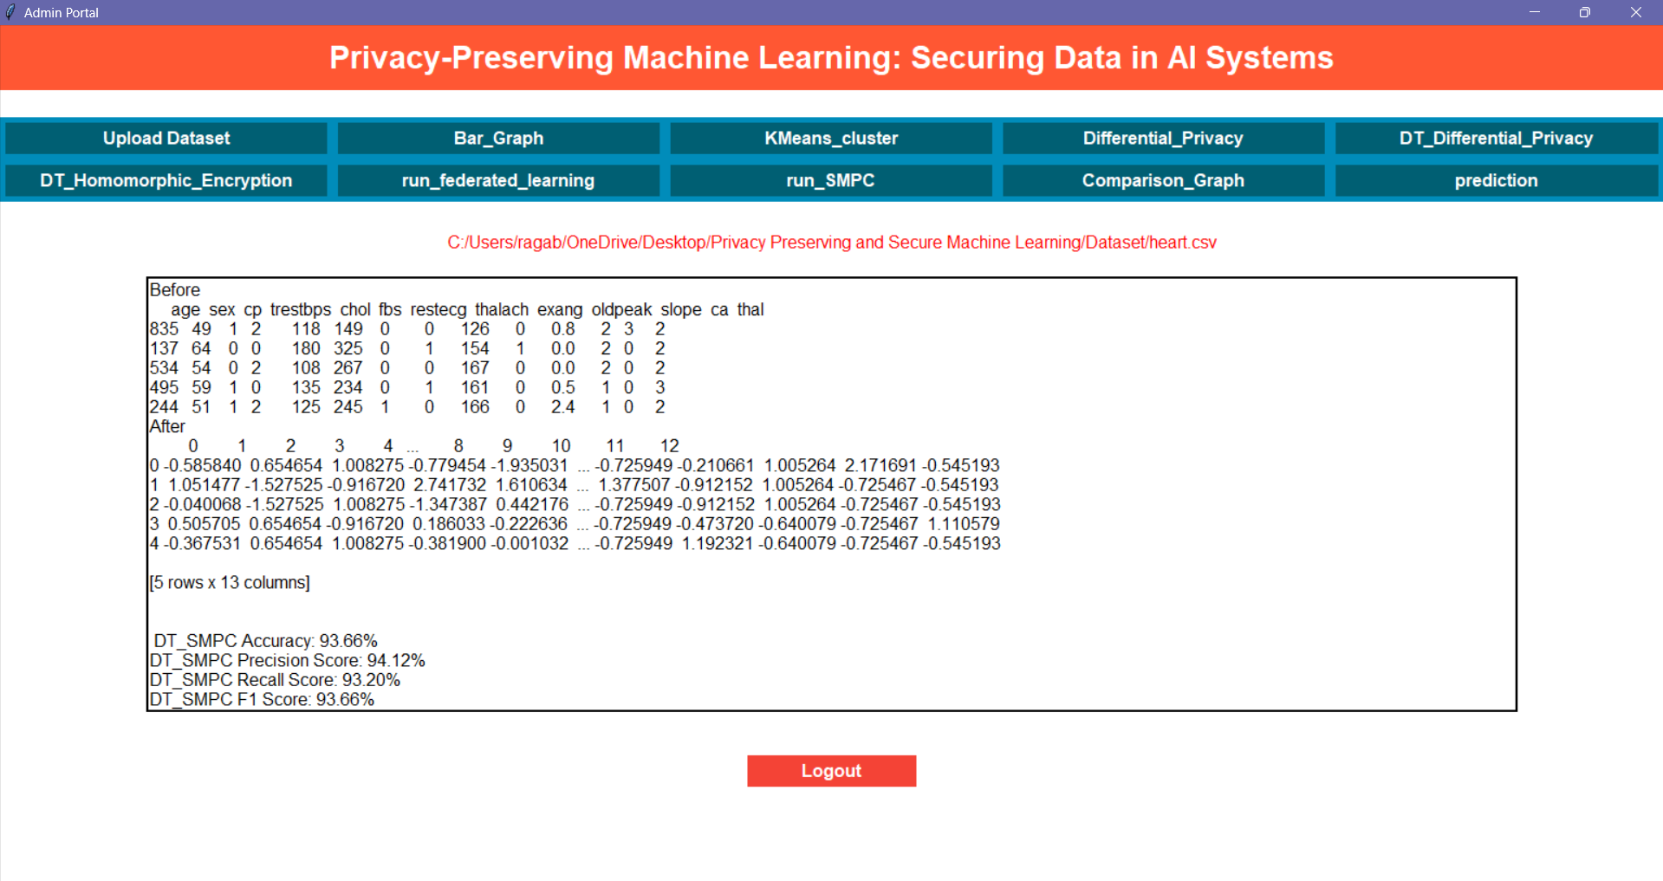
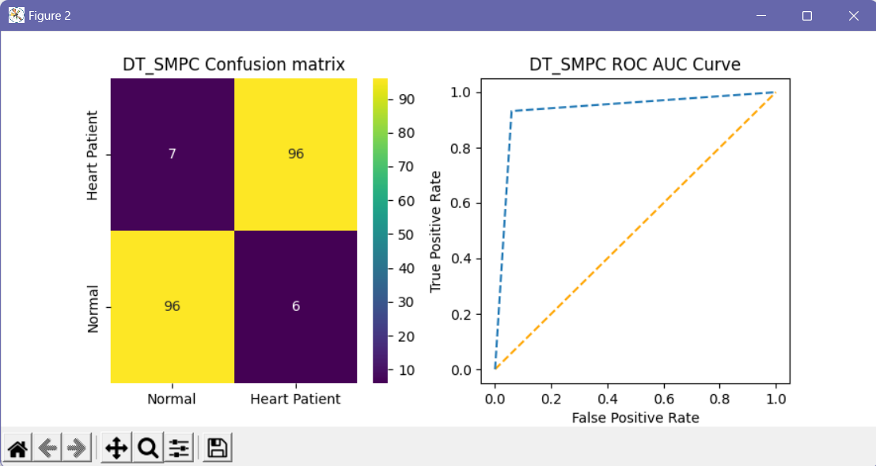
9

Slide 22
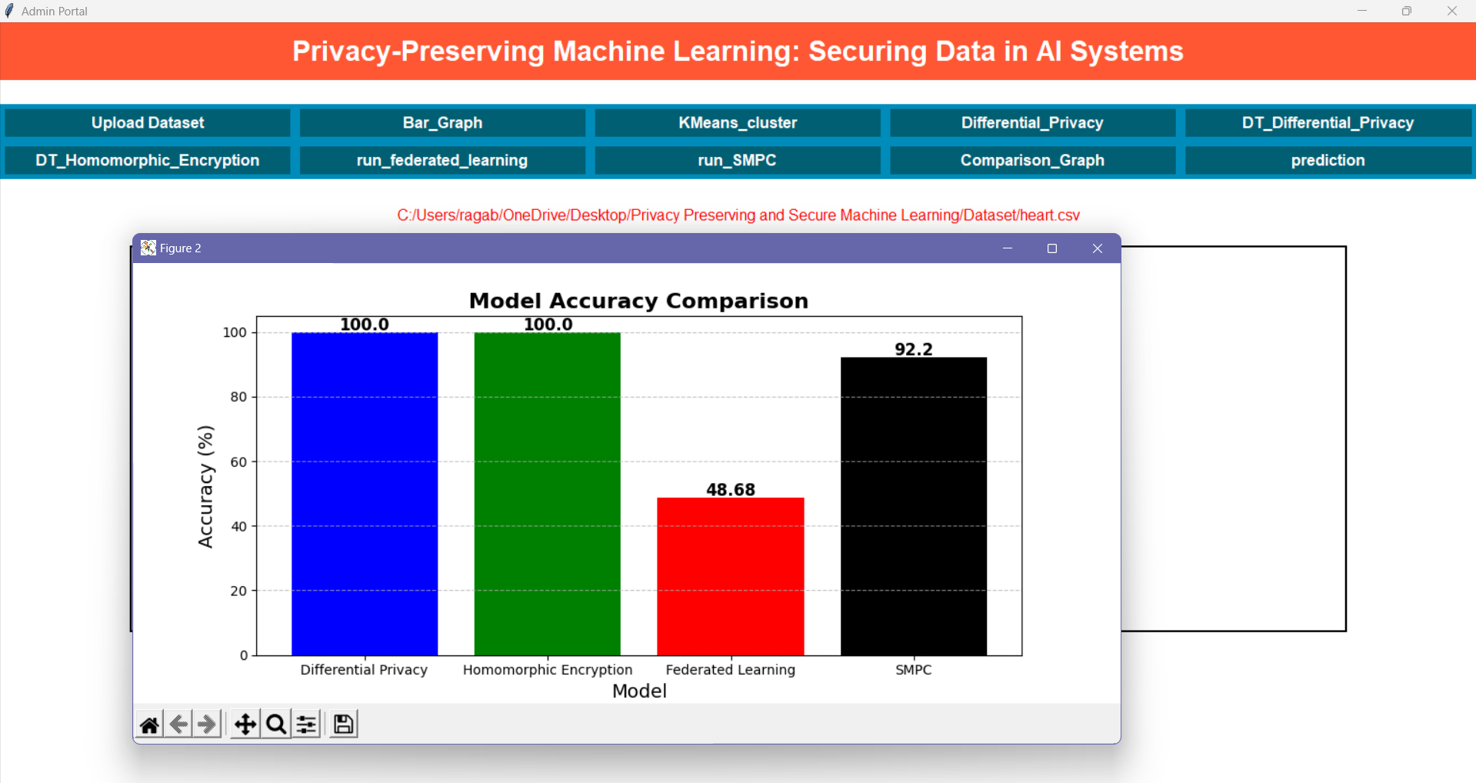
10

Slide 23
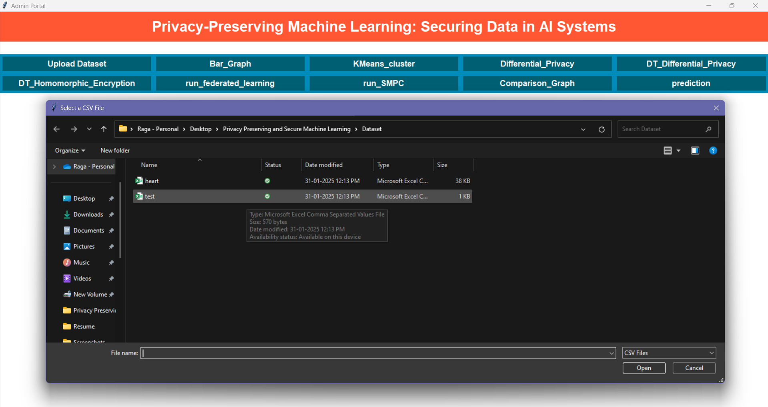
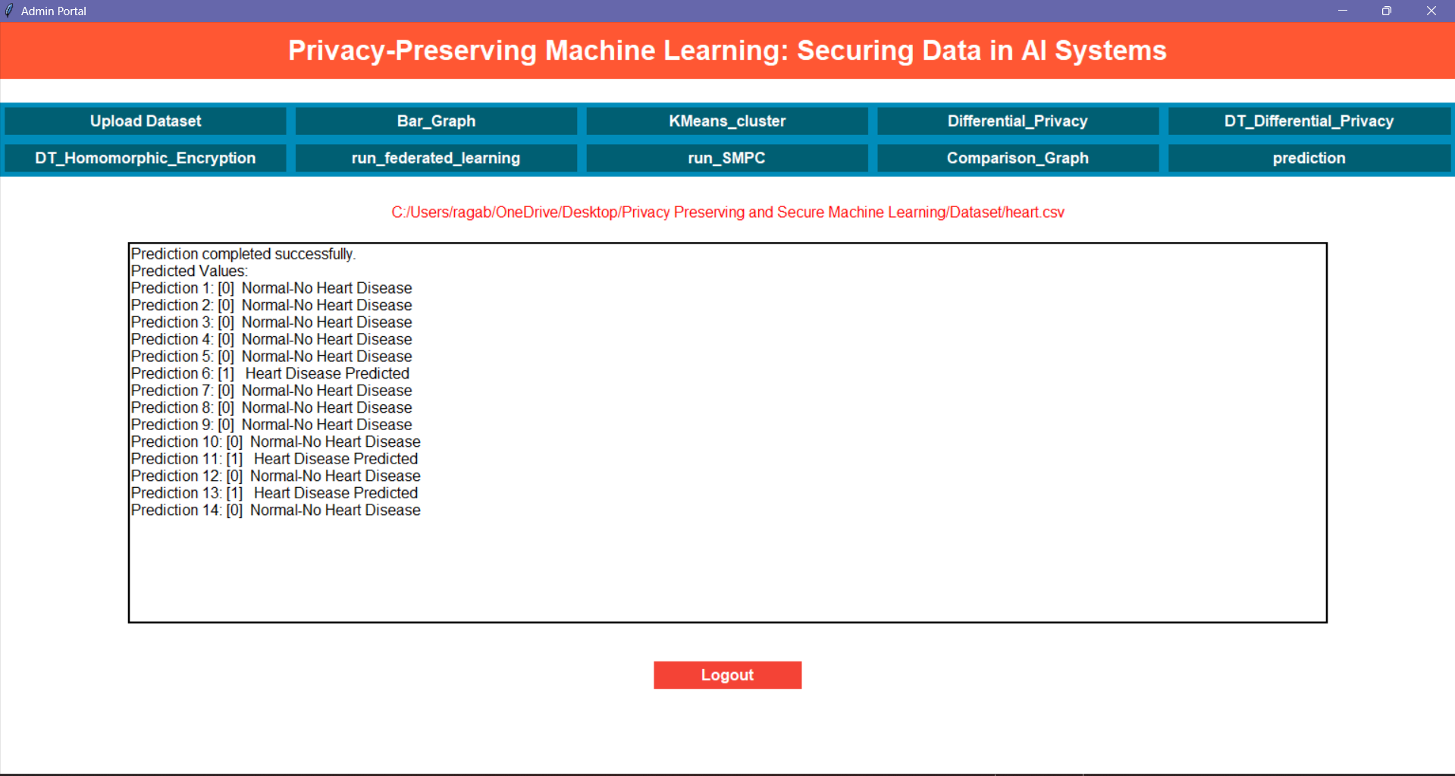
11

Slide 24
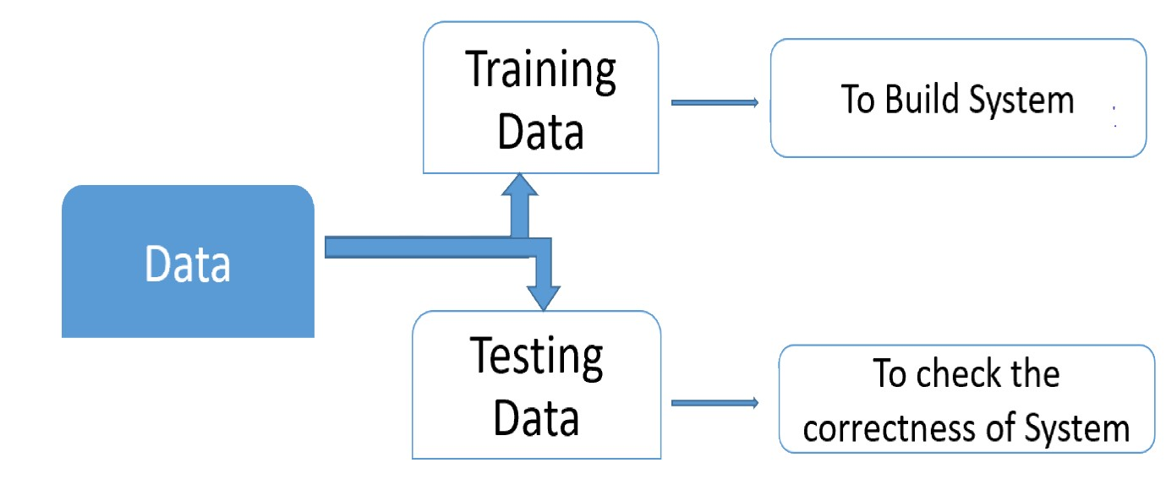
SOFTWARE DEVELOPMENT LIFE CYCLE

Slide 25
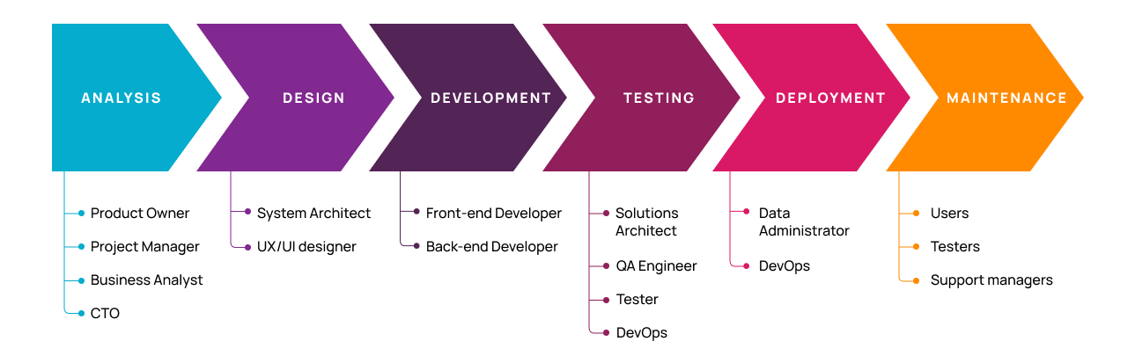
Planning: Define the project scope, goals, and feasibility.
Requirements Analysis: Gather and document the software's functional and non-functional requirements.
Design: Create architectural and detailed designs for the system and its components.
Development: Write and compile code based on the design documents.
Testing: Identify and fix defects to ensure the software meets requirements.
Deployment: Release the software to the production environment.
Maintenance: Monitor and update the software post-deployment to fix issues and add new features.

Slide 26
Future Scope
As technology advances, there are several ways to improve and expand privacy-preserving machine learning.
Quantum cryptography could be integrated to provide even stronger security at the hardware level. This would make data breaches almost impossible, even from quantum computers.
Real-time PPML solutions can be implemented on edge devices like mobile phones and IoT sensors. This would enable instant processing without data leaving the user’s device.
Social media platforms can benefit from PPML by offering personalized experiences without invading user privacy. This would improve trust and engagement.
Lastly, these techniques can be extended to natural language processing (NLP) and computer vision, allowing privacy-safe applications in voice assistants, facial recognition, and healthcare imaging.

Slide 27

Conclusion
Privacy-preserving machine learning secures sensitive data in AI systems and becomes increasingly important as data collection grows.
The project highlights techniques like federated learning, differential privacy, and homomorphic encryption to protect privacy without reducing model performance.
These approaches empower users to maintain control over their data, reduce risks of breaches, and build trust while supporting ethical AI practices.
Implementing privacy-preserving methods sets a new standard for responsible AI development and ensures compliance with legal and regulatory requirements.

Slide 28
References
[1] C. Dwork, "Differential Privacy: A Survey of Results," in Theory and Applications of Models of Computation, 2008.
[2] C. Gentry, "Fully Homomorphic Encryption Using Ideal Lattices," in Proceedings of the 41st Annual ACM Symposium on Theory of Computing (STOC), 2009.
[3] B. McMahan and D. Ramage, "Federated Learning: Collaborative Machine Learning without Centralized Training Data," in Google AI Blog, 2017.
[4] A. Shokri and V. Shmatikov, "Privacy-Preserving Deep Learning," in Proceedings of the 22nd ACM SIGSAC Conference on Computer and Communications Security (CCS), 2015.
[5] Y. Lindell and B. Pinkas, "Secure Multiparty Computation for Privacy-Preserving Data Mining," in Journal of Privacy and Confidentiality, 2009.
[6] R. Shokri et al., "Membership Inference Attacks Against Machine Learning Models," in IEEE Symposium on Security and Privacy (SP), 2017.

Slide 29
THANK YOU

